Slide 1
Run Airbnb vs Sell Property
Data Mining
TEAM #2
Changrui Xin
Erin E McNally
Jonathan Pena
Jiahui Ren
Tyler DiNapoli-Chiappelli
Matthew T Rogers

Slide 2




Problem
Analyze and predict whether a homeowner/apartment-owner would generate higher returns by selling their property or by listing it on the Airbnb platform.
OR

Slide 3

DIDA
Data: NYC Property Sales Dataset and an NYC Airbnb Dataset; New York Metro Transit Authority on the locations of subway stops; additional data detailing additional costs with renting a property on Airbnb and selling your home
Insight: IF a property’s expected revenue stream is greater on the AirBnB market than on the traditional market, THEN an owner should rent rather than sell. Else, vice-versa.
Decision: Whether any given property owner should sell on the traditional real estate market or rent on Airbnb in order to secure better revenue.
Advantage: Maximizing the value of a residential property in some “future state” real-estate market in New York City, given the assumption that the post-COVID-19 market will bear enough resemblance to the pre-COVID-19 market

Slide 4

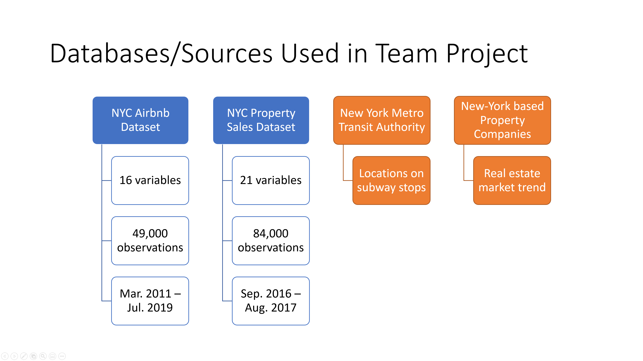
Data exploration

Slide 5
Inventory of Information
AirBnB Data | NYC Property Sales Data | NYC Subway Data | Potential AirBnB Costs | Potential Selling Costs
ID | borough | stopID | Payment Processing Fee | Realtor Commission Fees
name | neighborhood | name | Annual Website Advertising Fee | Closing Costs
host_id | building class category | Longiture_Latitude | Per-Booking Fee | Staging
host_name | tax class at present | line | Guest-Oriented Supplies and Amenities | Improvements and Renovations
neighbourhood group | block
neighbourhood | lot
latitude | ease-ment
longitude | building class at present
room_type | address
price | apartment number
minimum_nights | zip code
number_of_reviews | residential units
last_review | commercial units
reviews_per_month | total units
calculated_host_listing s_count | land square feet
availability_365 | gross square feet
 | year built
 | tax class at time of sale
 | building class at time of sale
 | sale price
 | sale date

Slide 6
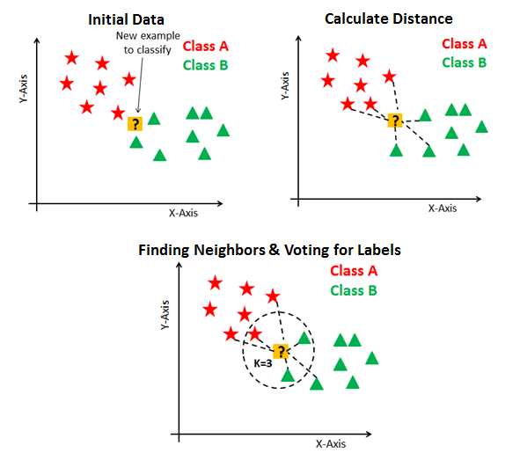
04 Data Mining Technique - KNN or Nearest Neighbor Model
Supervised data mining technique in which an algorithm can accurately predict the future value of a new data point
The model optimizes the number of observations or “K”, from the initial dataset to include so that accuracy is optimal
Analyzes the nearby observations or neighbors by Euclidean distance to produce an educated sense of value for the new data point
Fig.1 Avinash Navlani, https://www.datacamp.com/community/tutorials/k-nearest-neighbor-classification-scikit-learn, August 2nd, 2018

Slide 7
Data Mining Technique - kNN or Nearest Neighbor Model Cont’d
Our kNN model used the below features to provide a comprehensive description for each property while building out our kNN model
tax class,
building type
borough name
cost adjusted sale price
residential units
commercial units
land square feet
gross square feet,
year built
subway stops nearby

Slide 8
Data Mining Technique Why Not?
LASSO – Data set was not normally distributed
Linear Regression – Data set was not normally distributed
Neural Network – Provides probabilistic analysis
Logistic Regression – Not trying to gain probabilistic insights
Classification Tree – Does not provide

Slide 9

Python Implementation
Our Python and “Pre-Python” work consisted of 11 total steps. Here is the summary:
Pre-Python:
In underlying data files, transform revenue into “revenue minus costs”, a.k.a. profit by researching and subtracting out expected costs to holders of property.
Python:
- AirBnB data was already pretty clean upon download, so just clean NYC Real Estate.
- For both AirBnB and NYC Real Estate, prepare longitude and latitude data and calculate the number of subway stops near each property.
- Create “milestone data sets”.
- Run KNN model for both AirBnB and NYC Real Estate.
- Realize we were overfit to the AirBnB dataset. Continue with only NYC Real Estate.
- Run “naive median model” to compare results with KNN.

Slide 10

Results
Data Mining techniques are regarded as sophisticated. “Take the median” is derided as brute statistical force. What’s the difference in our project?
We grabbed 26 records from the historical data at random, standardized them, chopped off the DV, and fed them into Python as a “new data” test. But it’s a test we know all the answers to!
KNN Model:
Applying the KNN model to these 26 records gave us 26 predicted prices (shock!). Since we know what the values actually are, we calculated the ASE for this trial.
ASE = 0.987
Naive Median Model:
Taking the median of all historical prices gets us $552,614.89 as the predicted value for all future prices.
ASE = 1.037

Slide 11
KNN vs. Naive Median Model
For instant side-by-side comparability, we took the ratio of the two ASEs.
This ratio shows that the “naive median” prediction is only 5% more error-prone than KNN:
Naive Median Model ASE / KNN ASE = 1.037 / 0.987 = 1.05
However, 5% more average error is quite a lot in business terms!
Taking the 26 kNN estimates and subtracting the median value of $552,614.89 from each of them often yields a difference of prediction in the hundreds of thousands or even millions of dollars!
Top three examples: $8,927,857.82, $8,289,042.42, $5,100,618.69

Slide 12

Conclusions/Takeaways
Given the failure of the AirBnB portion of our analysis, it is necessary to modify parts of our original DIDA framework:
Data: NYC Property Sales Dataset; New York Metro Transit Authority on the locations of subway stops; additional data detailing additional costs with selling your home.
Insight (modified): IF the predicted profit of a given property is favorable to the owner, THEN it should be sold. Else, said owner can use our prediction information to re-balance their portfolio accordingly.
Decision (modified): Whether a residential property owner should sell their property or hold it as part of a portfolio rebalancing.
Advantage: Maximizing the value of a residential property in some “future state” real-estate market in New York City, given the assumption that the post-COVID-19 market will bear enough resemblance to the pre-COVID-19 market

Slide 13
Thanks for watching

